Slide 1
NBA Players Season 2017-2018 Daeseob Lim 5/6/2018
Abstract: Often times in basketball, it is hard to determine which basketball player is getting over paid and under paid, along with age’s affect on the league. And because looking at numbers on tables and comparing to another player’s numbers are often difficult especially with over 400 players, I have created a system to compare wage and rating, age and rating, and age and wage by position.

Slide 2
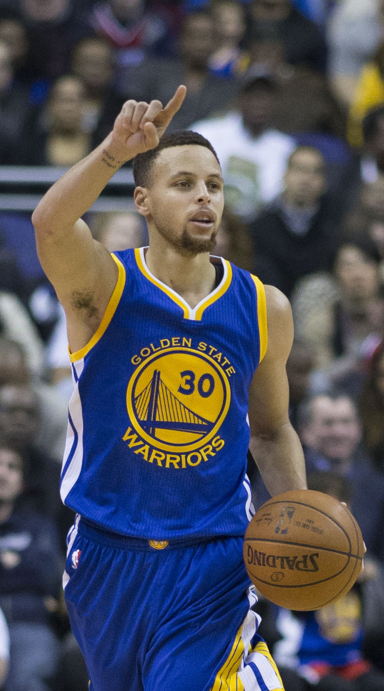

Background
Stephen Curry who is supposedly the best point guard in the NBA earned $34,682,550 in 2017-2018 season. And Paul Millsap who earned $31,269,231 However, are they actually worth that much money?
As our body gets old, our muscles tighten up and are more prone to injuries. Does age impact a professional NBA player’s body and his performance?

Slide 3

Technical Approach - 1
To compare wage and rating of a player and to determine the correlation , I have created a rating for each player by position and compared it to their contract signing for this season.
With the new rating of each player, I plotted their wage with their rating. After, I ran MyLineFit to determine the best fit line and calculated the rSq value.

Slide 4
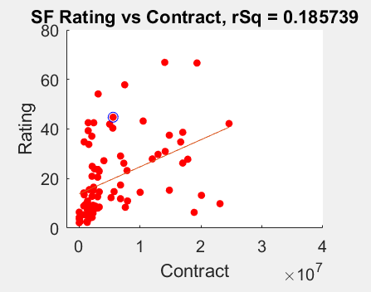
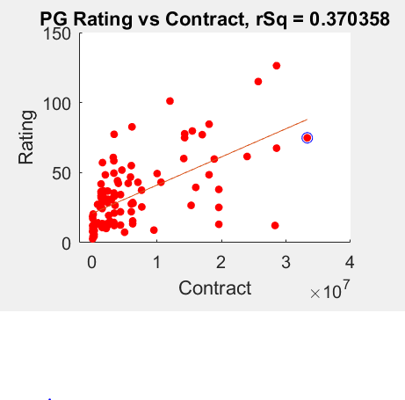
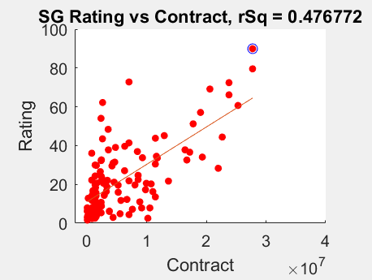
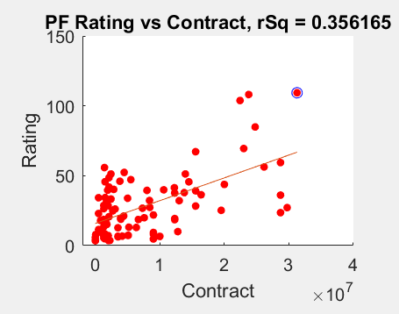
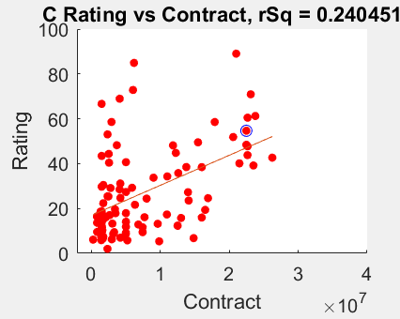
Results- 1

Slide 5
Results- 1
None of these show very strong correlation between a player’s skill and their pay. This can be due to my rather simplistic model of rating players and/or players who have bias stats due to their little playing time.
With that aside, there seems to the strongest correlation between wage and rating for shooting guards. Whereas, other positions show weak to little correlation.
(Please ignore the blue circles)

Slide 6
Results- 1
To determine whether a player is underpaid or overpaid, one must look at the line of best fit. If the player is over the line, he is underpaid, while if the player is under the line, he is overpaid.
Example:
Stephen Curry (blue circle)
Under the line
By logic, he is over paid

Slide 7
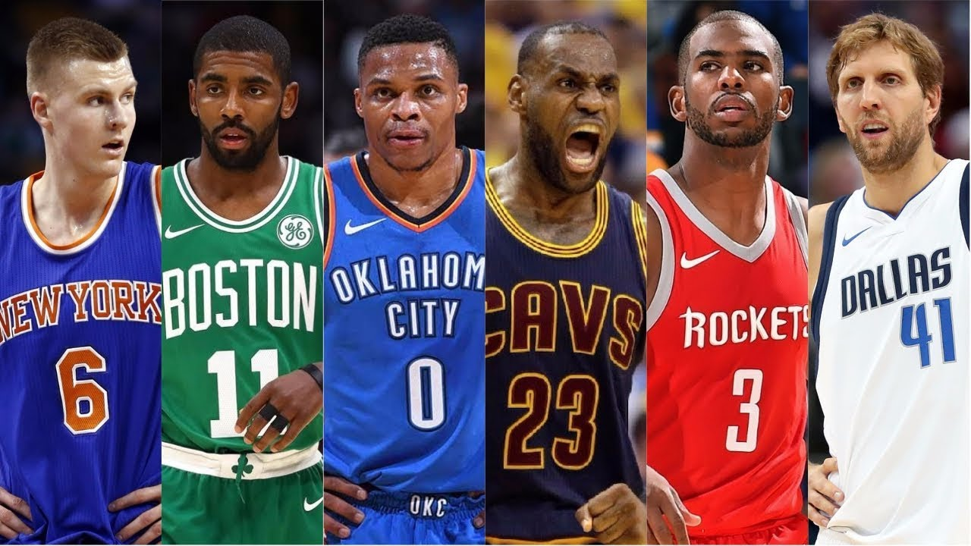
Technical Approach – 2
Similar to finding the wage and rating of players, I compared the age of each player with his rating.
To determine the correlation, I scatter plotted rating along with their rating. And after, I used MyLineFit to determine the rSq value and the line of best fit.

Slide 8
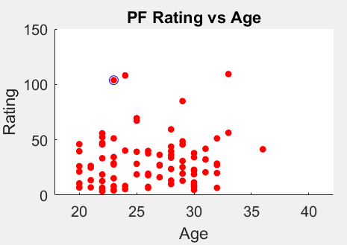
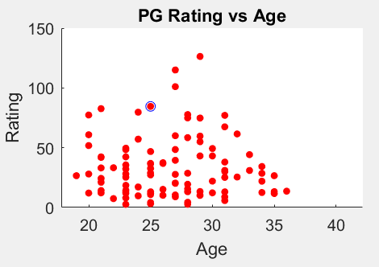
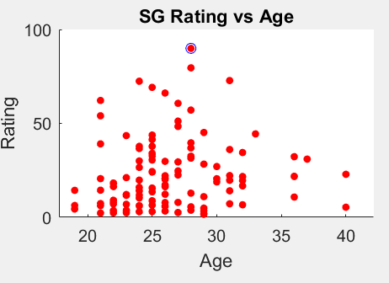
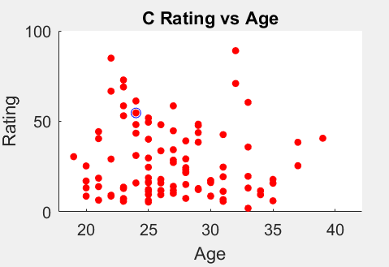
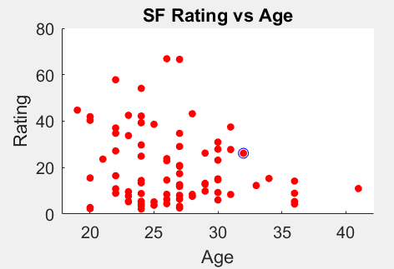
Results- 2

Slide 9
Results- 2
None of these show very strong correlation between a player’s skill and their pay. This can be due to my rather simplistic model of rating players and/or players who have bias stats due to their little playing time.
With that aside, I have plotted the line of best fit on age and rating, and the rSq value was less than .01. Therefore, I have decided not to include the line of best fit in my graphs.
The graph shows where your player lies compared to other players
(Please ignore the blue circles)

Slide 10
Conclusions and Next Steps
The next step for this project to create a better and more accurate rating system of each player.
With the appropriate data, my code can be used for future seasons, not just 2017-2018 season (data must be from basketball reference due to formatting).
Player’s rating and player’s wage have intermediate correlation; whereas, player’s rating and age have little to no correlation.

Slide 11
Data Extraction Hardships
The data was extracted from three different excel files. With the three different excel files, it was difficult to pull out every player by position. Furthermore, it was challenging to pull out all the different statistics by the position of each player.
I understand on the surface, my project is just plotting data given by a website. However, indexing through multiple vectors and attempting to separate them by positions was one of many hardships in my project.

Slide 12
References
www.basketball-reference.com
My project working, in case it doesn’t
https://www.youtube.com/watch?v=sXWq2VLf31g&feature=youtu.be

